Slide 1




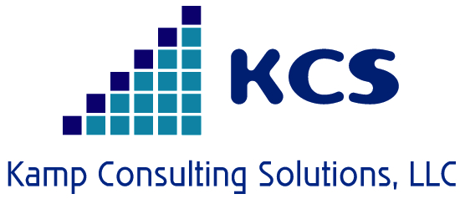
…
Defined Benefit
Plans

Slide 2

Discussion Topics
Firm Introduction
DB Plan Existence
History of U. S. Retirement Plans
Public Pension Plans
Retirement Concerns
Impact on Plan Sponsors / Participants
Back to Basics
New Game Plan
Key Takeaways

Slide 3
Kamp Consulting Solutions, LLC
Principals have more than 130 years of direct investment, asset consulting and plan sponsor experience
Asset consulting is our only business
Unique understanding of the asset / liability relationship
100% employee-owned

Slide 4
Why Do Defined Benefit Plans Exist?
The purpose for providing a retirement plan is to achieve key stakeholder objectives. Who are the stakeholders in public pension plans?
Employers, who seek to attract and retain qualified workers needed to perform essential public services
Taxpayers, who seek the provision of public services at a cost that is fair and reasonably stable and predictable
Employees, who seek compensation that is competitive and a retirement benefit that promotes retirement security

Slide 5
History of U. S. Retirement Plans
In 1717, The Presbyterian Church creates a Fund for Pious Uses to provide for retired ministers.
In 1889, American Express Company launches the first private pension plan in the U.S.
There are 421 private plans launched by 1929, including GE, AT&T, Goodyear, Kodak and US Steel and by 1970, 46% of private workers are covered by a DB plan.
Today, we’ve witnessed a dramatic reduction in the use of defined benefit plans, and <20% of private sector is now covered by a DB plan.

Slide 6
History of U. S. Retirement Plans
Public funds started with various promises made to veterans of the Revolutionary War
Civil War veterans enjoyed more extensive benefits
Public plans expanded greatly by state and local governments during the progressive era of the late 19th century
Civil service retirement system created in 1920 to cover civilian employees in the federal government
Replaced by federal employee retirement system in 1987

Slide 7
Important Legislative Milestones
Revenue Acts of 1921, 1926 and 1928 – impacted tax treatment of contributions into plans
In 1935, the Social Security Act is signed by FDR
Revenue Act of 1938 made pension trusts irrevocable
1947, the Labor-Management Relations Act (aka “Taft-Hartley” Act), establishes operation of plans administered jointly
Welfare and Pension Plan Disclosure Act of 1958 limits fiduciary abuse
  In 1962 this plan is amended to shift responsibility for protection of plan assets to the federal government

Slide 8
Important Legislative Milestones
Employee Retirement Income Security Act of 1974 was enacted was designed to secure benefits
The Revenue Act of 1978 established Qualified deferred compensation plans (401(k))
The Economic Recovery Act of 1981 raised contribution limits on IRAs and Keogh plans
Tax Reform Act of 1986 established faster vesting schedules, changed rules for the integration of pension plans with Social Security and mandated broader coverage of rank-and-file employees

Slide 9
Public Sector Workforce
A public employee is almost twice as likely to have a college degree than a private sector worker
More public employees work in professions that involve physical risk: law enforcement, firefighting, corrections, hazardous materials
Many public sector positions are career-oriented, such as education, finance, and public safety
Public sector worker median tenure is 7.0 years, compared to 3.5 for the private sector

Slide 10
Public Plan Elements
Mandatory participation
Employee-employer cost sharing
Assets that are pooled and professionally invested
A benefit that cannot be outlived
These features promote retirement income security

Slide 11
Public Pension Plans
Each of the 50 states have at least one retirement system for employees
5.1 million full time and part time state level government employees covered
13.2 million local government employees covered
Connecticut has roughly 187,000 FTE public positions*
*US Census Bureau, March 2009 payroll data

Slide 12
Public Pensions: Key Statistics
DB plans for state and local government employees in the U.S.
    $3.0 trillion in assets
    18 million active (working) participants
    12+ percent of the nation’s workforce
US Census Bureau, Public Fund Survey

Slide 13
Public Pensions: Key Statistics
8 million retirees and their survivors receive $200
billion annually
85%+ of state and local government workers
participate in an employer-sponsored pension plan
Of 2,500+ public retirement systems, the largest 75
account for 80% of assets and members
Aggregate funding level = 77%
US Census Bureau, Public Fund Survey

Slide 14

The Looming Retirement Crisis?

Slide 15
Pension Contribution Spending
State/ local governments contribute $86 billion annually to public employee pensions
Employees contribute $40 billion annually
In 2012, of everything state/local governments spent, 10% was
spent on public employee pension contributions
This is up from 7.5% in 2007
Should and will be higher in many states and cities
Of the 250 largest US cities, more than ½ still have reserves less than 2007
levels
US Census Bureau, Center for Retirement Research, NASRA
Wall Street Journal and Merritt Research Services, LLC

Slide 16
Public Pensions: Unfunded Liabilities/Growing Costs
Failure to pay required contributions
Establishment of benefits without ensuring a sustainable
funding source
Failure to manage liabilities, such as through costly benefit
provisions
Failure to maintain appropriate actuarial assumptions
Investment losses since 2000
All of these factors except the investment losses are within
the control of the plan sponsor or employer
Plans that have avoided these factors are in good condition

Slide 17
How Agencies Deal with Lower Revenues
For public employees:
Furloughs, layoffs and attrition
The state and local government workforce is 3.5 percent below its peak level in September 2008
  >600,000 jobs
Salary cuts and stagnant salary growth
Employees are paying a larger share of the cost of pensions and other benefits
One if 5 cities reduced pension benefits in 2013 fiscal year*
* Wall Street Journal and Merritt Research Services, LLC

Slide 18
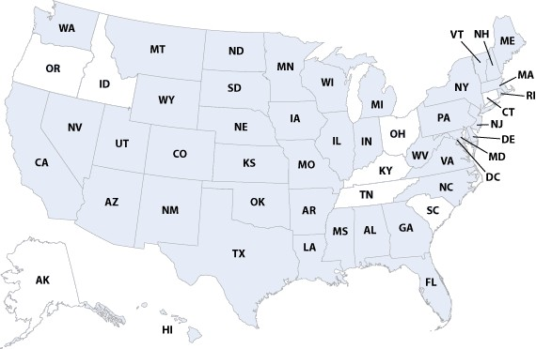
Response to Higher Pension Costs
Since 2009, 42 states have made changes to their pension benefits, required employee contributions, or both

Slide 19
Causes for Concern
Three or four legged retirement stool is now a one
legged high-wire act
Today, fewer than 20% of the U.S. private sector
workforce participates in a defined benefit plan, down
from more than 46% in the 1970’s
Today, more than 40% of the private sector workforce
are now in DC plans, which provide their only retirement
income
Today, Social Security, personal savings and home equity
are inadequate to effectively make up for the lack of a
steady retirement income provided by DB plans

Slide 20
Recent Reforms
According to the National Conference of State Legislatures, since 2009, an “unprecedented” number of states made changes to their pension plans
Reforms vary by groups affected:
  New hires only
  Current active members
  Current retired members
Most common changes: higher retirement age; more required years of service; longer vesting periods; higher employee contributions; elimination of employee non-contributory plans
Notable changes: increased retirement eligibility criteria for current actives; reduced, postponed, or eliminated COLA for current retirees

Slide 21
Notable State System Changes
In 2010, three states—CO, MN, SD—modified COLA provisions for current retired members
Nine more states reduced COLA provisions in 2011
  Three —ME, NJ, OK—affected existing retired members
At least 15 states raised employee contribution rates, some affecting existing participants
Other changes:
  Longer final average salary periods, more restrictive return-to-work policies, anti-spiking provisions

Slide 22
Hybrid Plans
Nebraska provides a cash balance to its state and county workers, as do the Texas municipal and county & district plans
  Plans are in solid funding condition
Combination DB/DC plans, featuring a reduced DB component combined with a DC plan
  Georgia
  Indiana
  Michigan
  Ohio
  Oregon
  Utah
  Washington

Slide 23
Employer Challenges with DC Only Offerings
Loss of a human resources management tool
A pension plan is particularly helpful for retaining qualified workers needed to perform essential public services
Retention is key for certain groups: teachers, law enforcement personnel, and members of other career-oriented groups
A pension plan promotes the human resources management objective of orderly turnover, i.e., retirement, or ability to retire, at an appropriate age
Orderly turnover facilitates workforce management objectives and can modify salary growth

Slide 24
Experience with DC Only Public Plans
Nebraska found that its defined contribution plan for state and county workers was resulting in workers reaching retirement financially unprepared
  Switched to a cash balance plan in 2003
West Virginia switched its teachers to a DC plan in 1993, then back to the pension plan in 2005
  Experience with a DC plan went badly
Michigan state workers hired since 1997 have only a DC plan
  DB plan cost has risen to 17 percent of pay to amortize the UAL
  The state is saving solely because of low participation in the new DC plan
Alaska closed its pensions to all new hires in 2006
  DB plan cost has risen sharply since

Slide 25



Participant Feedback EBRI Survey
Overall, how confident are you that you (and your spouse) will have enough money to live comfortably throughout your retirement years?
In 2013, 51% of active workers responded that they are very or somewhat confident about having enough money. This is down from the 70% peak that was achieved in 2007…just before the market crash of 2008.
Overall, how confident are you that you will have enough money to take care of your basic expenses during retirement?
In 2013, 70% of active workers responded that they were very or somewhat confident about covering basic expenses, down from the 82% peak reading in 2007. Not surprisingly, the presence of debt reduced the workers’ retirement confidence.

Slide 26
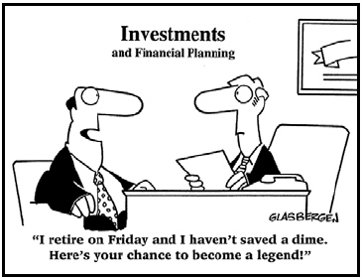
Participant Dilemma

Slide 27
Participant Feedback EBRI Survey
Are you (and/or your spouse) currently saving for retirement?
57% of active workers responded that they are saving, down from a peak of 65% in 2009. However, the question to ask - are they saving enough? Do future retirees truly understand what there annual needs will be and how those might change over time?
In total, about how much money would you (and your spouse) currently have in savings and investments, not including your primary residence?
57% responded that they have less than $25,000 saved for retirement, which has been fairly consistent over the past 10 year survey period.

Slide 28
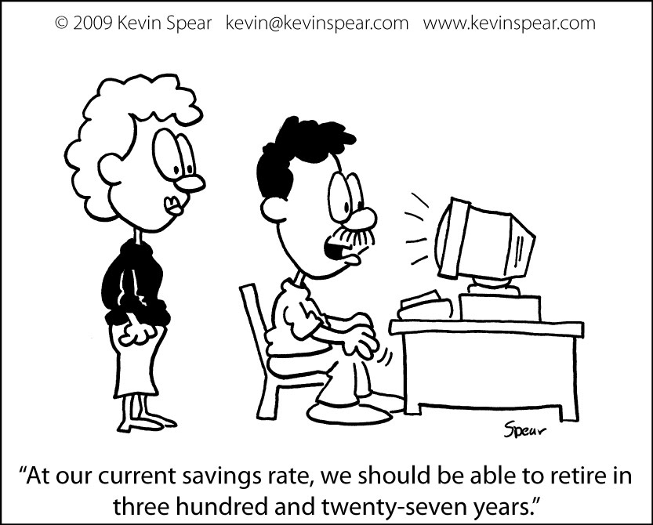
Participant Dilemma

Slide 29
Employee Challenges in DC Only Environment
Leakage – assets leaving the retirement account before the account holder reaches retirement age
Fees – the cost of a typical defined contribution plan exceeds one percent of assets annually
Lower investment returns – DC plans underperform professionally managed retirement pools by around one percent annually
Timing – an employee who retires during a down market will suffer relative to those who retire during an up market
Longevity risk – a retiree could outlive their assets

Slide 30
DB – A Better Bang for the Buck?
2008 study, updated in 2011, by the National Institute on Retirement Security
Key finding: A traditional pension can deliver the same retirement income at significantly lower cost than an individual defined contribution (DC) account.
This is due to
  lower pension plan administrative and investment costs
  higher investment earnings
  and pooled assets that spread risk over long periods and many lives

Slide 31
Plan Sponsor Challenges
Significant asset bases and, in many cases, more significant liabilities
Not comfortable with the complexity of offerings in the global markets, especially in situations in which internal resources are limited
How does one achieve the ROA assumption?
Committee structures can make timely decision making difficult

Slide 32
Plan Sponsor Challenges
Difficult for sponsors to forecast returns, risk and correlation in short term periods, let along long-term
Focusing on ROA has proven to be difficult due to volatility
Asset allocation decisions historically accounted for 80% to 90% of a plan’s total return, but have generally focused on long-term, strategic goals associated with the ROA assumption
Should consider your plans specific liabilities and not solely an arbitrary ROA

Slide 33

Preserve DB Plans – A New Game Plan
Becoming liability aware in conjunction with return parameters can help plan sponsors achieve the goal of providing plan participants the benefits they were promised

Slide 34

New Game Plan
A plan specific Custom Liability Index (CLI) will enable plan sponsors to evaluate how the plan’s assets need to perform relative to the liabilities, which will drive asset allocation decisions
Knowing the score is essential to adjust your offense and defense – play conservatively or aggressively when you know the score
Your plan’s funding status should determine which plays you will run from the playbook

Slide 35
New Game Plan
A plan’s asset allocation should be constructed to include portfolios with the objectives of matching and funding liabilities (Beta portfolio) along with outperforming liabilities (Alpha portfolio)
Beta portfolio is similar to old time football….3 yard gain and a cloud of dust
Alpha portfolio is the your wide open passing game designed to outperform the other team – liability growth
As the game evolves, you have to adapt your playbook for outcomes
As your funding improves, you can protect your lead
You’ll most likely be able to use most of your team members, but you may have to grab a free agent or two
Can use some lower cost players to accomplish the goal

Slide 36
Key Takeaways
Retirement security benefits everyone
Core elements of public pension plan design promote retirement security:
  Mandatory participation
  Employee-employer cost-sharing
  Pooled assets invested by professionals
  Annuitized benefits
An employer-sponsored retirement benefit can serve as a workforce management tool and old-age poverty insurance
  Its primary purpose is not to generate wealth
As a large and stable employer, government is well-suited to sponsor such a benefit
Consider a New Game Plan
  Adjust your focus to become more liability aware
  You can win the game

Slide 37




Social Media
@ KampConsulting
@ RussKamp
Kamp Consulting Solutions, LLC
kampconsultingblog.com

Slide 38
Contact Information
Kamp Consulting Solutions, LLC
Russell D. Kamp
Managing Partner
34 Third Street
Midland Park, NJ 07432
973/509-4616 (office)
201/675-8797 (cell)
201/670-4454 (fax)
rkamp@kampconsultingsolutions.com
www.kampconsultingsolutions.com

